Slide 1


MODULE 4 :
WORKING WITH GIT & GITHUB (INDIVIDUAL REPOSITORY)
PREPARED BY:
Dr. Nurulaqilla Khamis Center for Artificial Intelligence and Robotics
Universiti Teknologi Malaysia

Slide 2

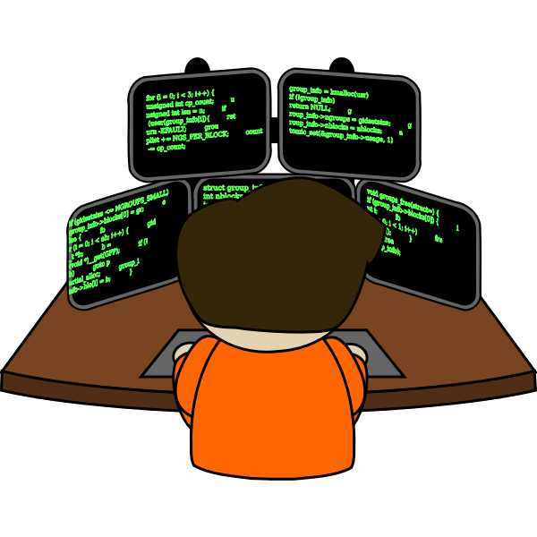

QUICK RECAP!
Notes: CLI much faster!
Command Line Interface (CLI)
To track changes, modify and version control:
version1
version2
.
.
versionN
Storage Space Your Project Repo/Online Hosting
Programmer
(Web Apps, Desktop Apps, Mobile Apps)

Slide 3

WORKING WITH GIT AND GITHUB
(INDIVIDUAL REPOSITORY)

Slide 4
Note: We will create new repo for this project and use Atom (source code editor)
Create Folder/Repo Project in your Local Machine
Create New Repository (GitHub)
Create New File (README, project file)
Initialize Project in Git
Add File from Local Machine to GitHub Repository
Commit Files in Git
Push Files in GitHub
Update Any Changes (Files)

Slide 5

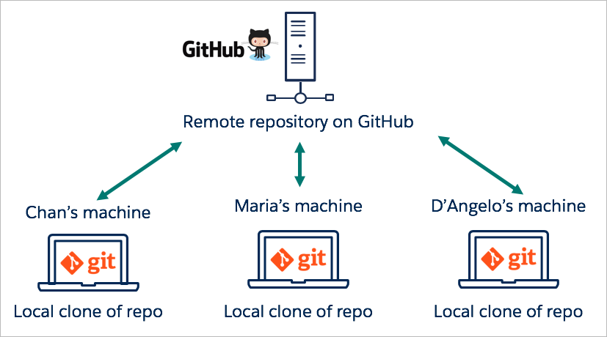

2
Folder/Repo: GitHubProject
Update Repo Repeat Step 5 - 7
README.MD
7
CLI :
git push
helloworld.c
6
CLI :
git commit –m “message”
Your Machine
1
Folder/Repo: GitHubProject
3
CLI :
git status
git add –A / git add . (All Files) @ git add [filename] (Single Files)
README.MD
5
helloworld.c
4
CLI :
git init
Programmer
Notes:
Point 7 Recap

Slide 6
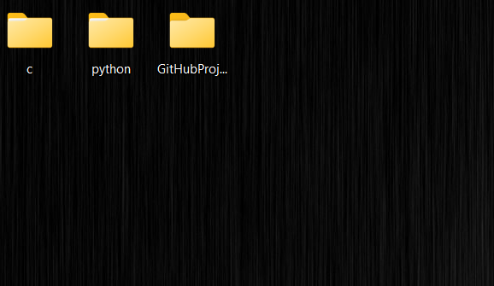
CREATE REPOSITORY PROJECT (LOCAL MACHINE)
Go to your “Desktop” > “Right Click” > “New Folder” > “GitHubProject”
Your Desktop

Slide 7
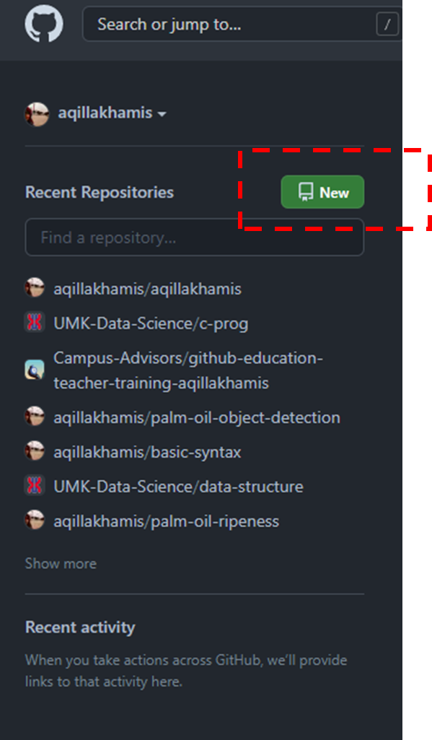

CREATE NEW REPOSITORY (GITHUB)
click “New” for new repository
www.github.com

Slide 8
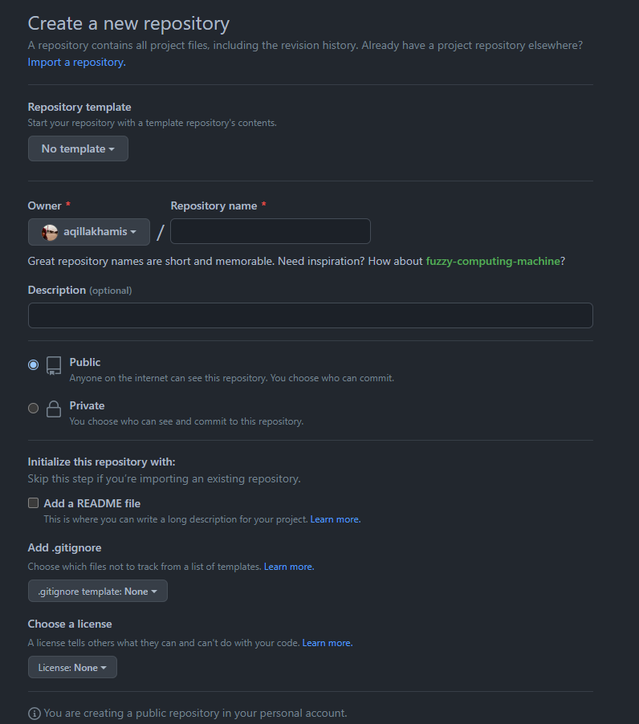

Repository name: Create similar project name from your local machine repo - “GitHubProject”
Description – Optional
Public @ Private Repo? (Your Choice)
Click “Create repository”

Slide 9
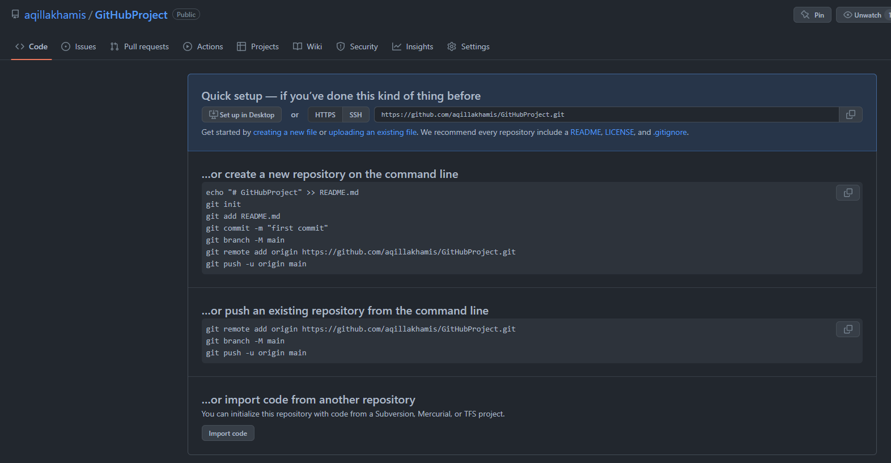

Slide 10

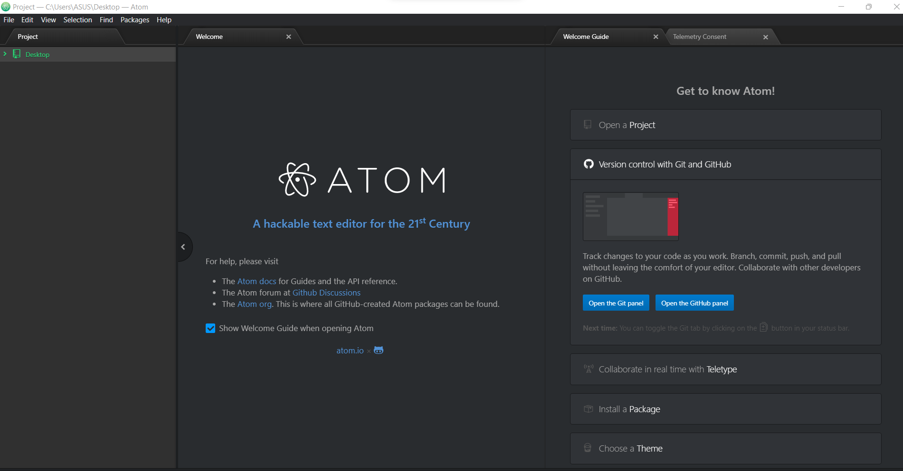
CREATE NEW FILE (“README.MD”)
Click “Atom” (source-code editor)
Click File > New File
Atom - free open source code editor support any programming languages 😃

Slide 11
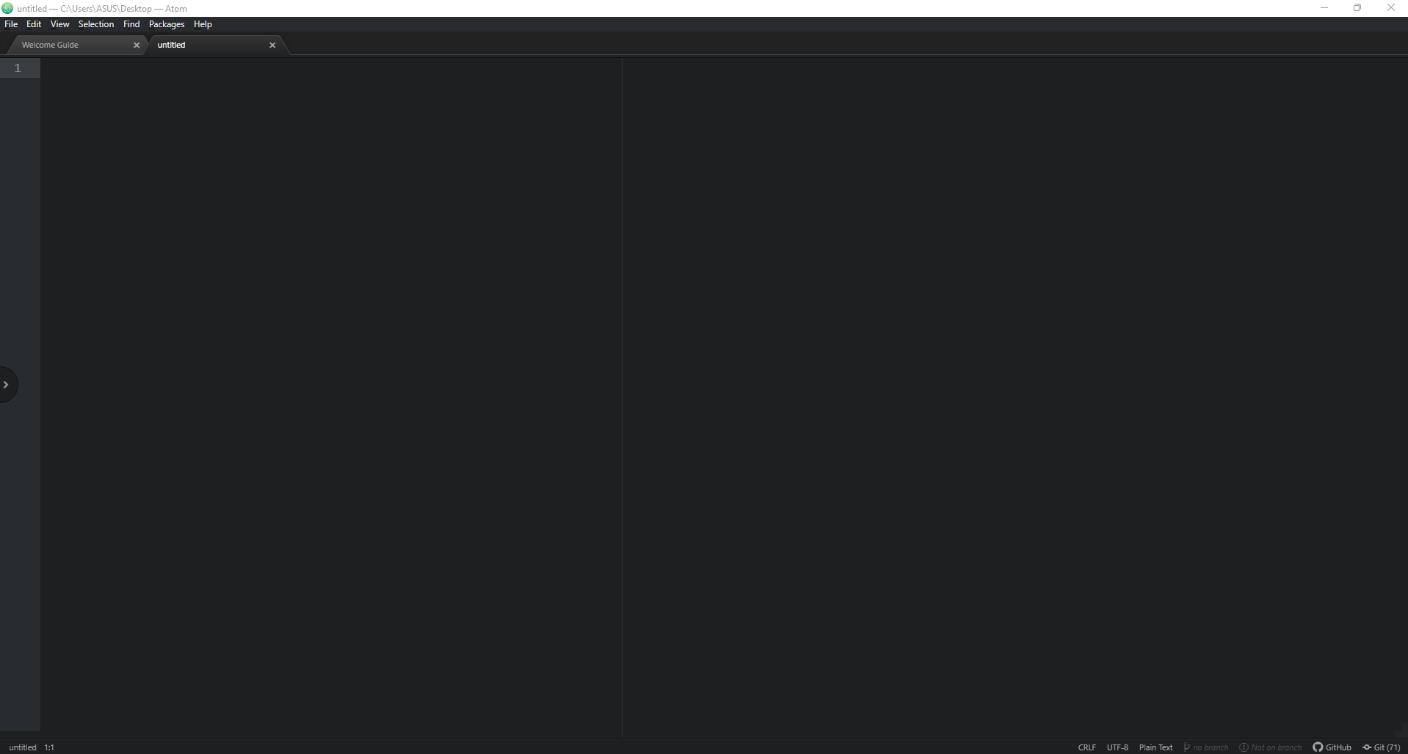
#include<stdio.h>
int main(){
printf(“Hello World!”);
}
Note: You will get an empty canvas.
We will write our code in here! 👾
Instruction:
After complete write the code, save the file by click File > Save As (Ctrl + s)
Save this file as “helloworld.c” inside your “GitHubProject” repo/folder

Slide 13
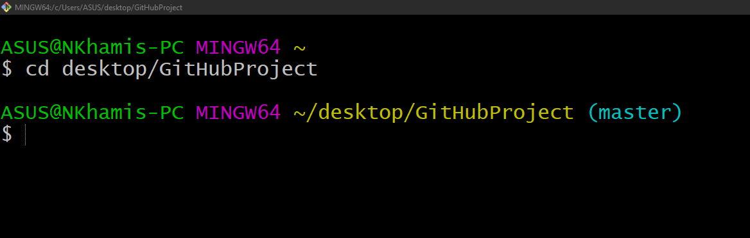
INITIALIZE PROJECT IN GIT
Open “Git Bash” (type at your search bar)
Change the path file that we want to access. Point it to your working repo.
Type “cd desktop/your_folder_name”
Now it will change to your repo path 😲

Slide 14
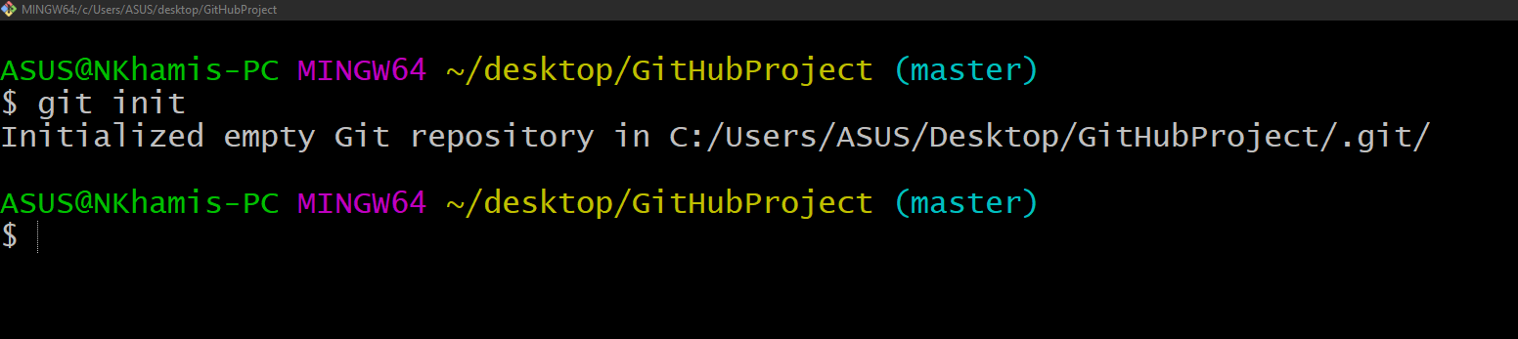
INITIALIZE PROJECT IN GIT
Initialize “git init” - this will tell Git to get ready watching your files for every changes that occurs
Git init - information about your local machine & path where the folder exists

Slide 15
ADD FILE FROM LOCAL MACHINE TO GITHUB REPOSITORY
git add README.md @ git add helloworld.c (if you want to add specific single file)
git add -A @ git add . (the period or dot that comes after add means all the files that exist in the repository)

Slide 16
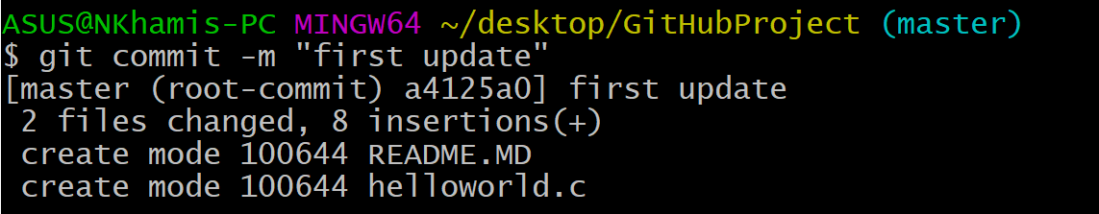
COMMIT FILES IN GIT
To commit our file, we use git commit -m “write your message”

Slide 17
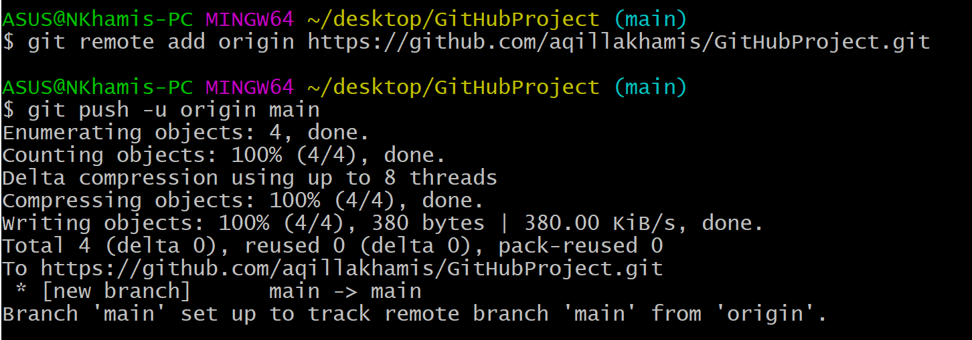
PUSH FILES IN GITHUB
git remote add origin [repo URL name] - create connection between your local repo and central repo on GitHub
git branch -M main
git push -u origin main : push your repo from local to GitHub

Slide 18
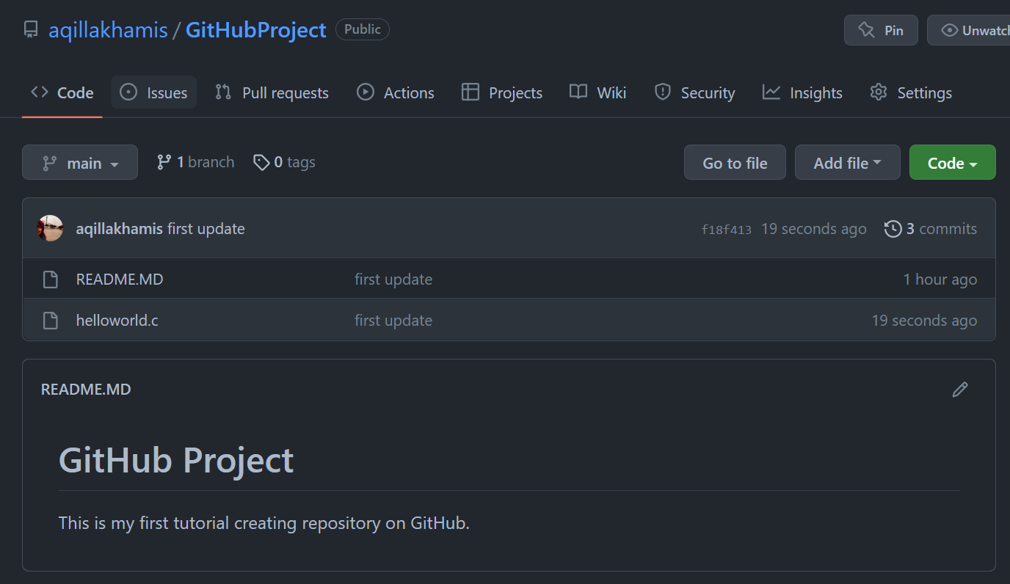
PUSH FILES IN GITHUB
Tadaa! 😄
You can see your files from local repo now inside GitHub repository

Slide 19
UPDATE ANY CHANGES (FILES)
#include<stdio.h>
int main(){
printf(“Hello World!”);
printf(“This is my first repository);
}
We are now adding new line here 👀
Instruction:
File > Save (ctrl + s)

Slide 20
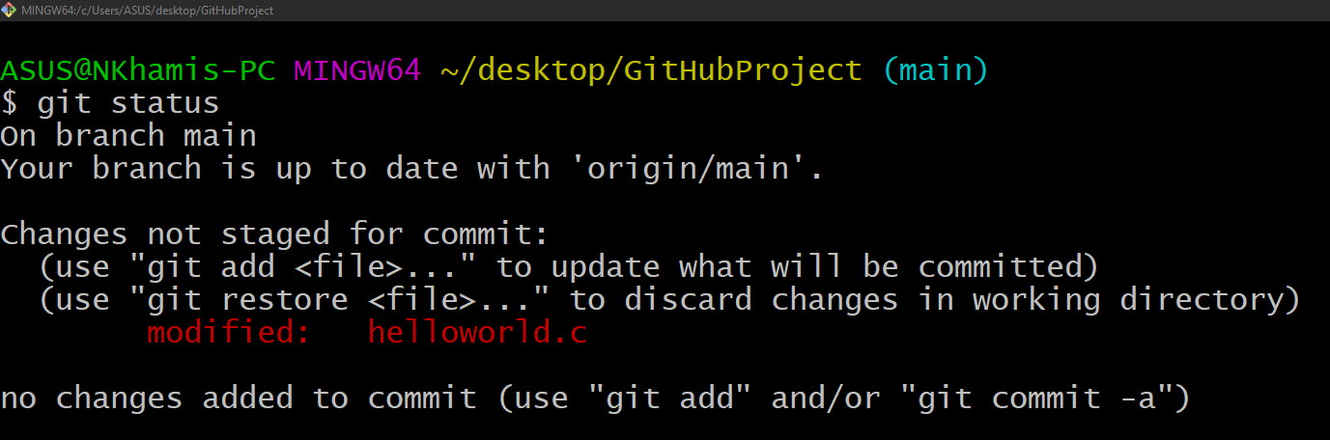
LET’S SEE WHAT GIT HAS FOUND? 😏
git status - every changes you made can be trace by type “git status”
Gotcha! got modification in our file, and git can trace 😎

Slide 21
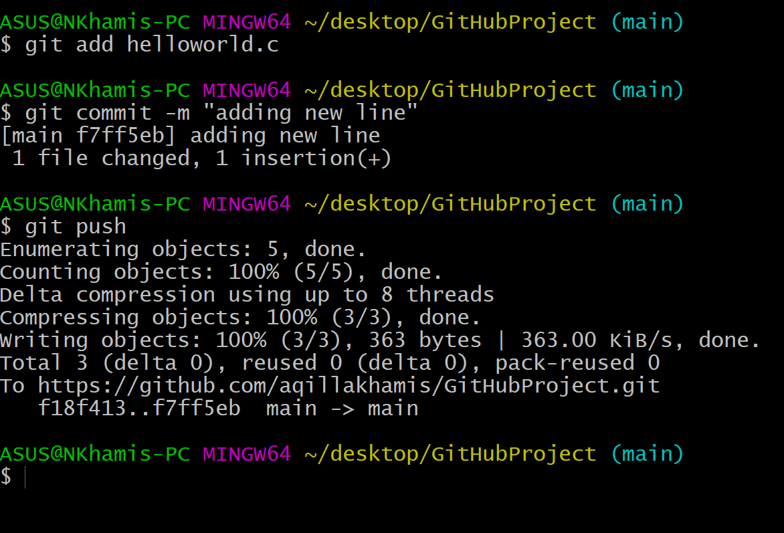
I WANT TO UPDATE CHANGES TO MY CENTRAL REPO (GITHUB). HOW CAN I DO THAT? 😰
Specify which file to update? git add filename
Put message before push, git commit -m “message”
Ready to push to your GitHub 😆! git push

Slide 22
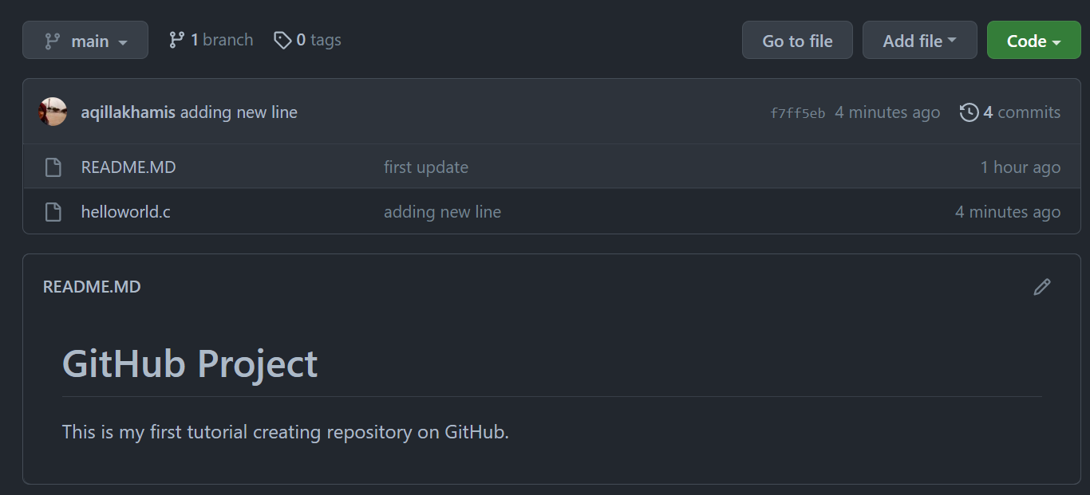
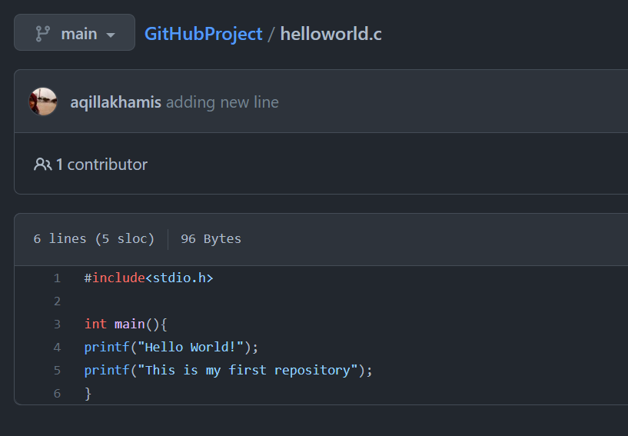
Let’s Check!
Refresh your GitHub repo
Click “helloworld.c” file
Everything update!

Slide 23

HANDS-ON
INDIVIDUAL REPOSITORY

Slide 24

HANDS-ON (1)
Create Folder/Repo Project in your Local Machine
Create New Repository (GitHub)
Create New File (README, project file)
Initialize Project in Git
Add File from Local Machine to GitHub Repository
Commit Files in Git
Push Files in GitHub
Update Any Changes (Files)

Slide 25
TAKE-HOME-MESSAGE 🙇
Create Folder/Repo Project in your Local Machine ✅
Create New Repository (GitHub) ✅
Create New File (README, project file) ✅
Initialize Project in Git ✅
Add File from Local Machine to GitHub Repository ✅
Commit Files in Git ✅
Push Files in GitHub ✅
Update Any Changes (Files) ✅
Practice Makes Perfect! 🎉

Slide 26
cairo@utm.my / trainer’s email

